Slide 1
How much is that doggie in the window?
Web scraping puppy ads with R
Jamie Ralph

Slide 2
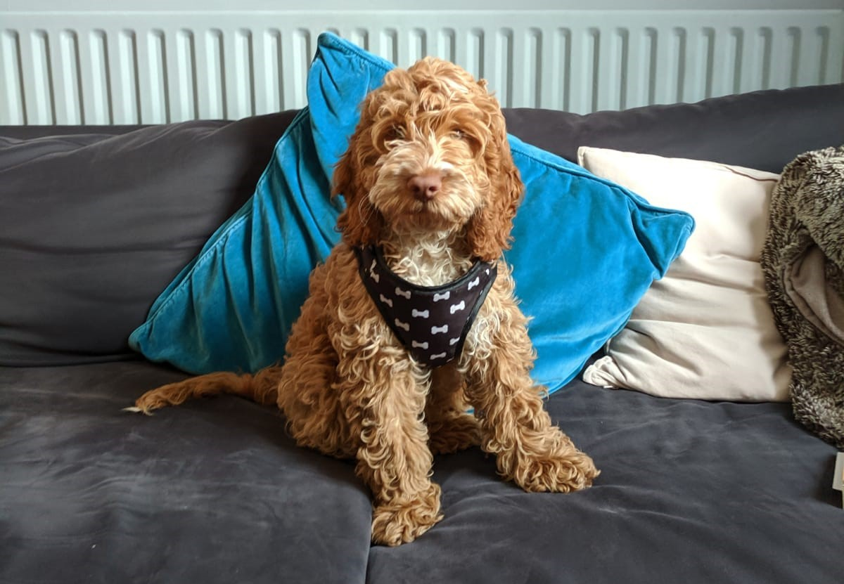
Today’s inspiration...

Slide 3
First generation?
Female or male?
Parental factors?

Slide 4

Rvest and xml2
headline
price
hyperlink
read_html()
html_nodes()

Slide 5
Tidying the data
Remove studs
Limit between £400 & £3000
Search for “pupp” using grepl()

Slide 6
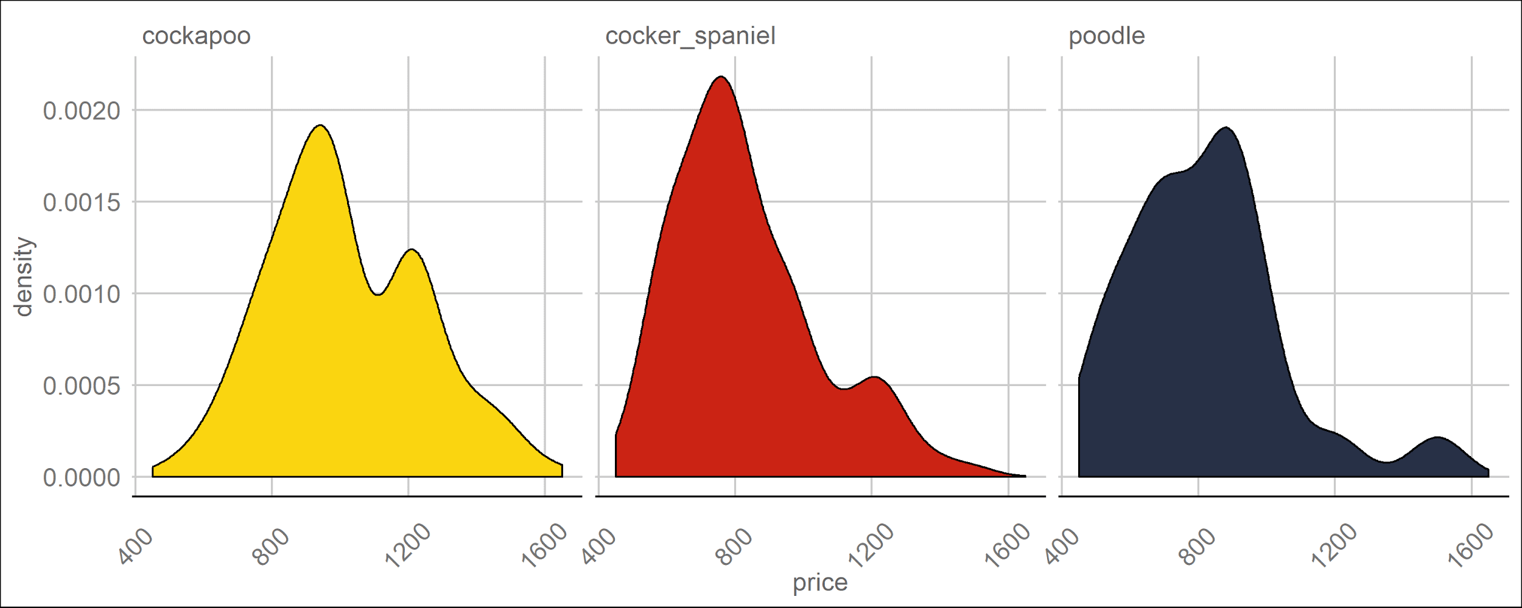
N = 213
Median = £995
N = 132
Median = £795
N = 24
Median = £800

Slide 7
N = 213
Median = £995
N = 132
Median = £795
N = 24
Median = £800

Slide 8
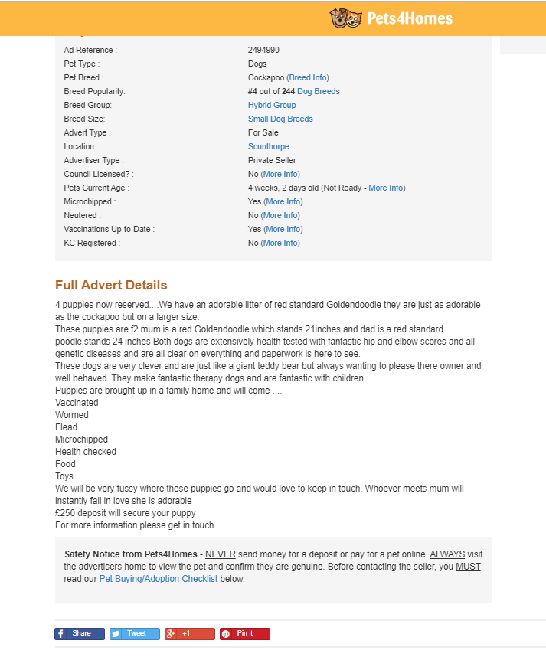
headline
price
hyperlink
description

Slide 9
tidytext
Take ads priced below 40th percentile & above 60th percentile
Extract words with tidytext package
Compare word frequency between lower and higher

Slide 10
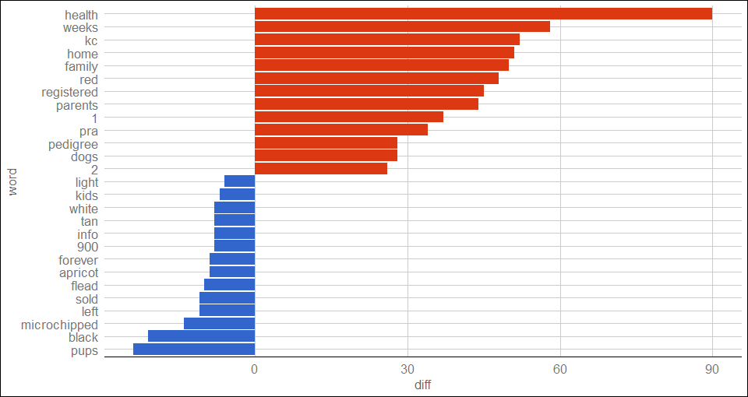

Slide 11
Repeating the analysis with bigrams...

Slide 12
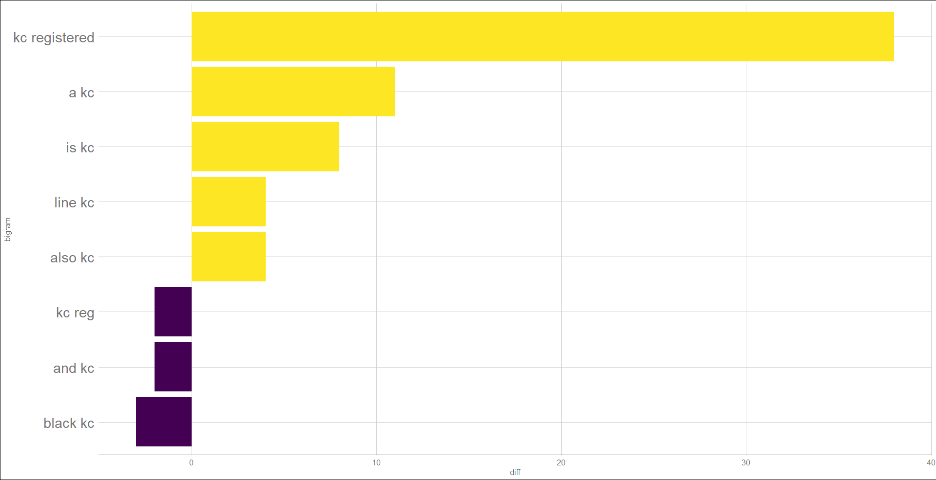

Slide 13
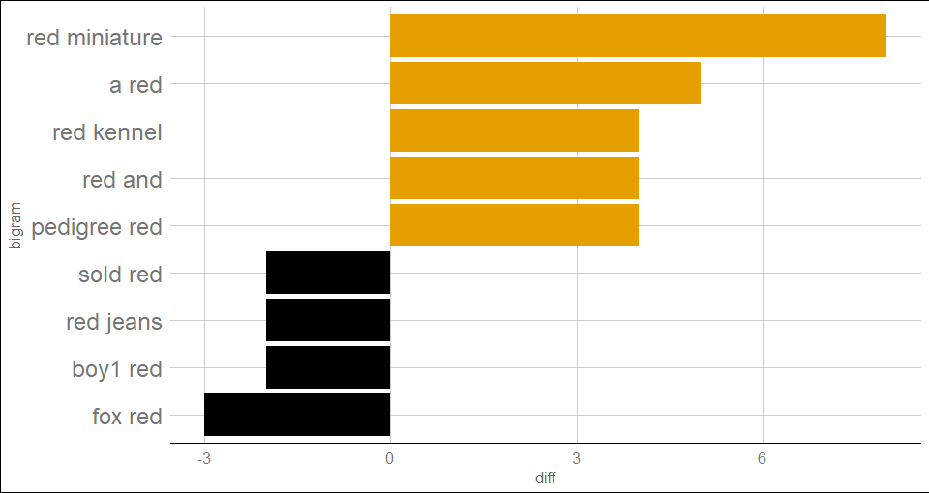

Slide 14
Improvements
Get more ads by changing search terms
Collect data over time
Use more information

Slide 15
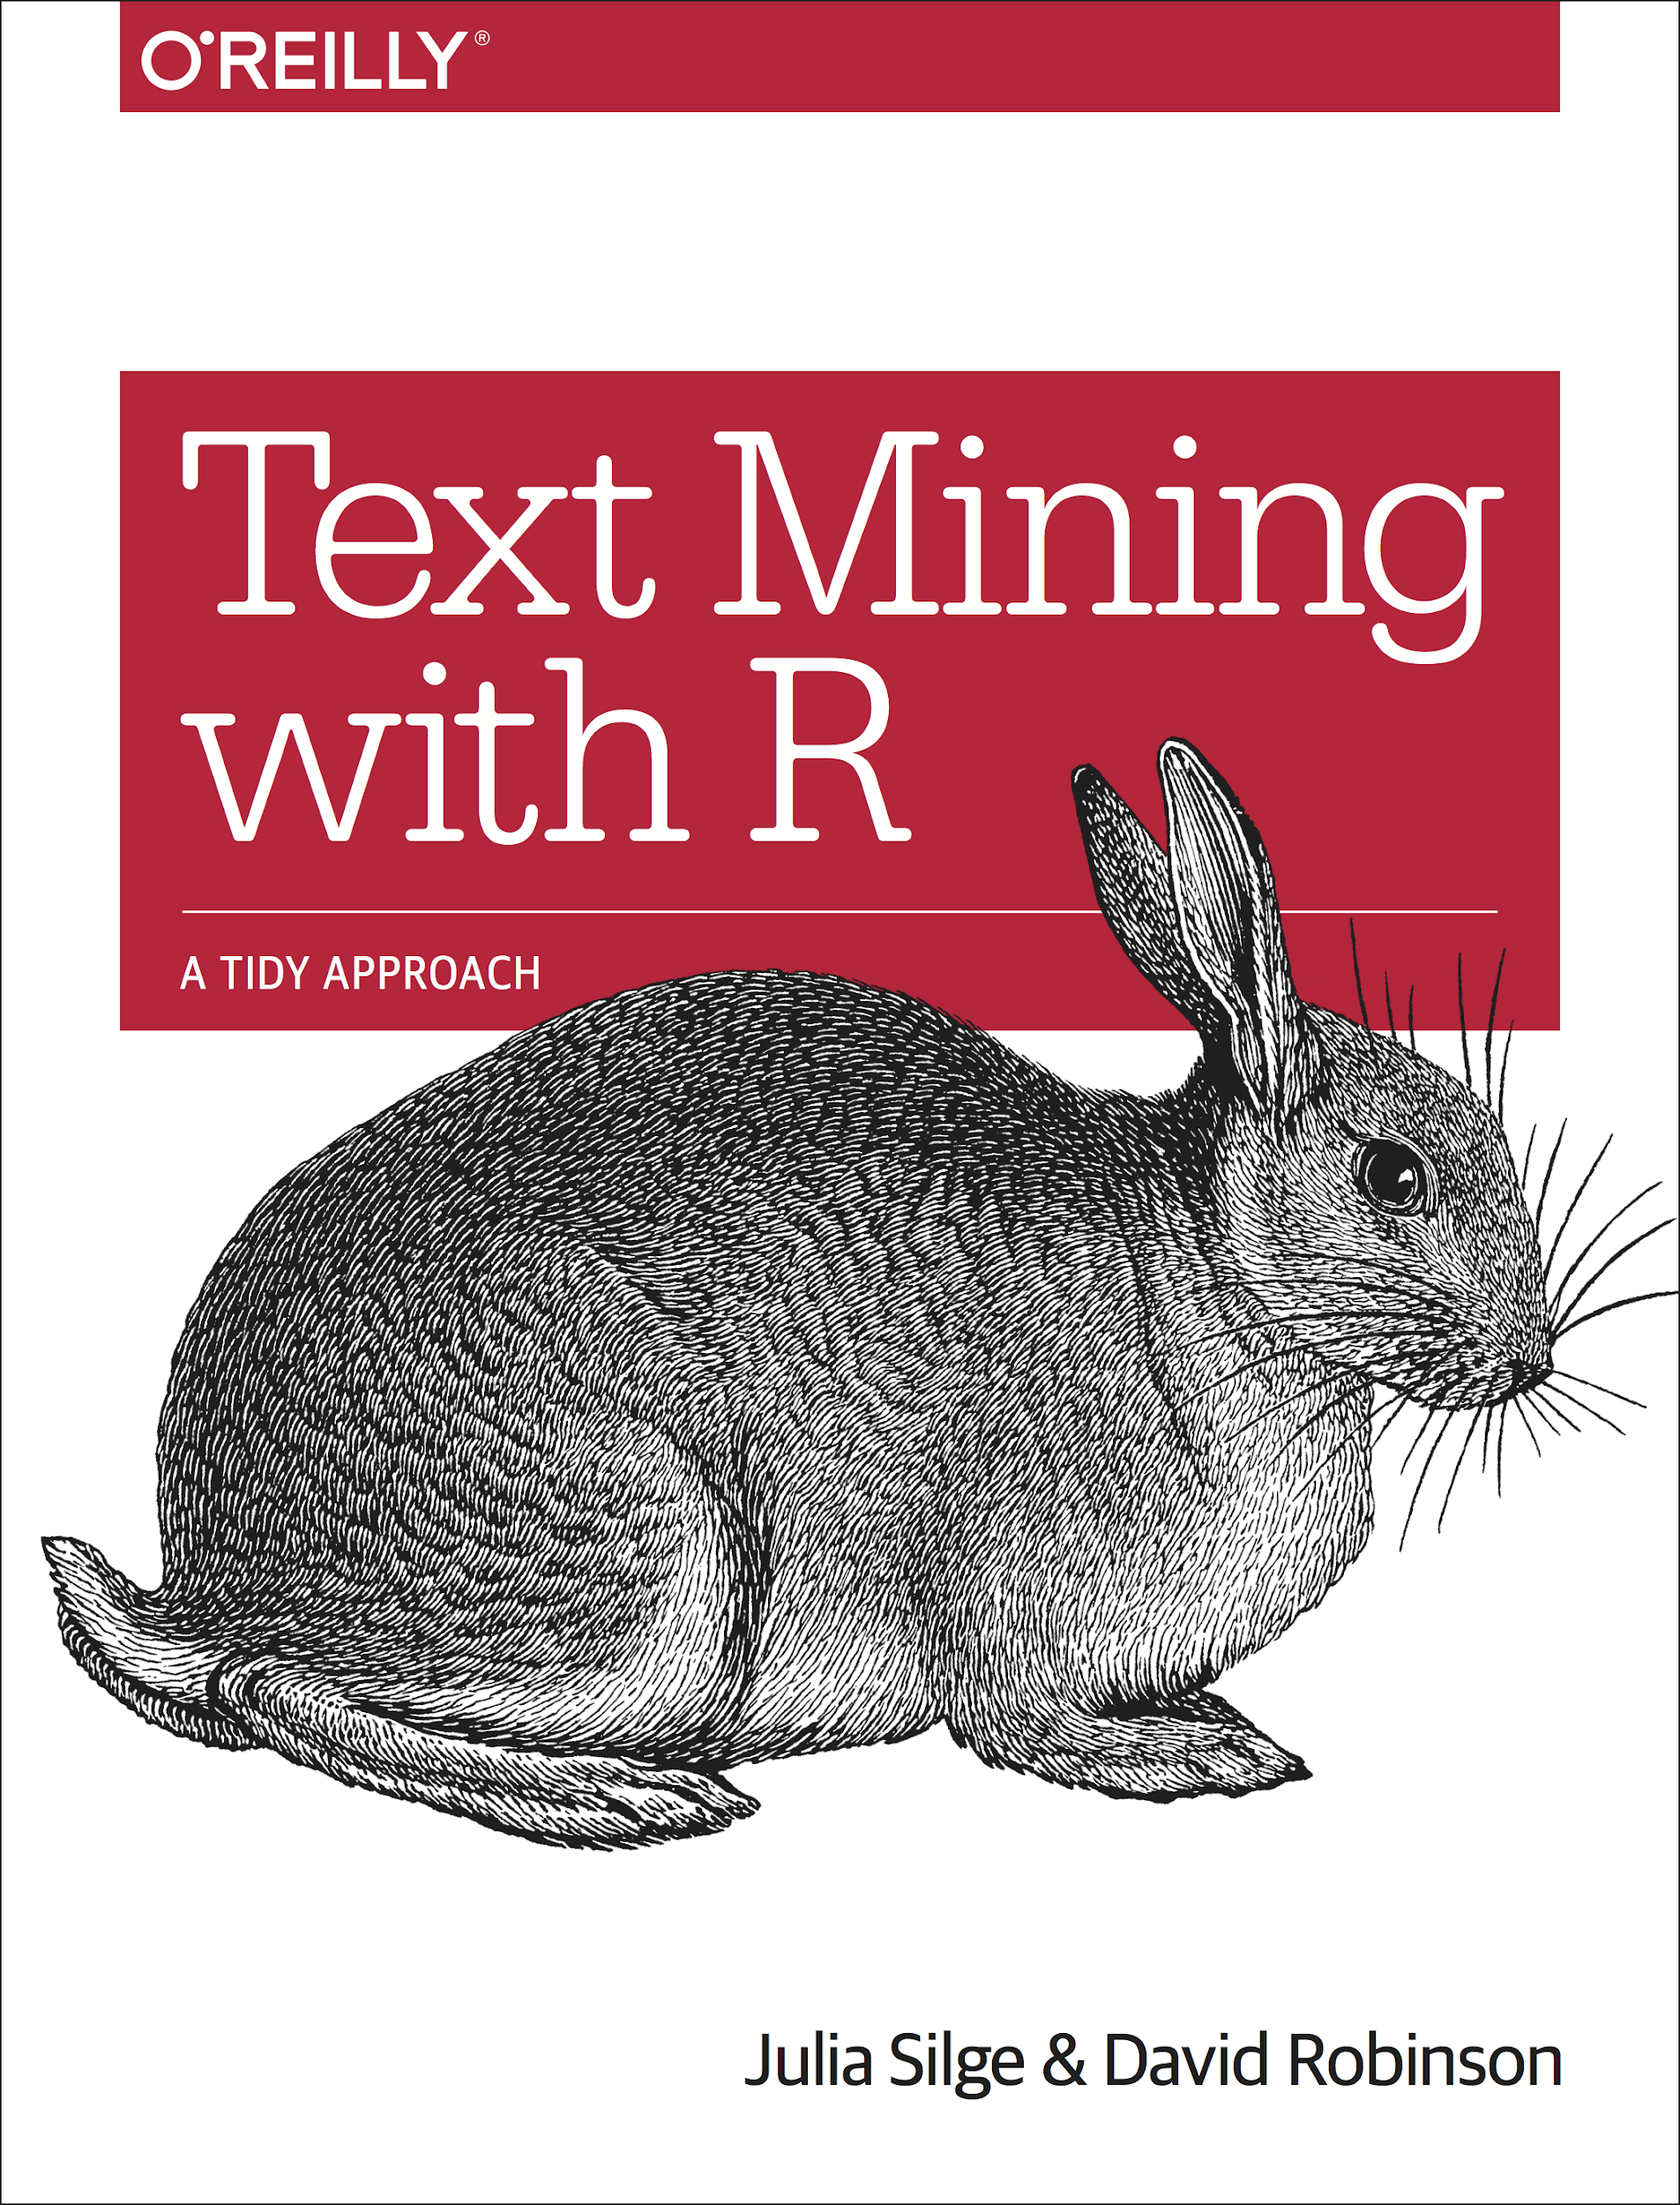
Acknowledgements
Web scraping tutorials - @olihawkins
Text Mining with R

Slide 16


Thank you!
@statsjam

